Slide 1


SITA1503 FOG AND CLOUD COMPUTING
UNIT -II

Slide 2
COURSE OBJECTIVES
➢ To understand the basic concepts of cloud computing and cloud enables.
➢ To understand cloud services and Multi-tenancy computing.
➢ To study about various models of cloud environments and virtualization.
➢ To manage the cloud computing infrastructure with security.
➢ To gain knowledge of cloud and to understand about Fog, edge computing.

Slide 3
UNIT 2 CLOUD SERVICE MODELS
- Software as a Service (SaaS)
Infrastructure as a Service (IaaS)
Platform as a Service (PaaS)
Web services
Service Oriented Architecture (SoA)
Elastic Computing
On Demand Computing
Service Management in Cloud Computing
Multi-tenancy computing , architecture

Slide 5


Contents
Introduction
Characteristics of SaaS
Types of SaaS
Architecture of SaaS
Software as a service providers
Advantages
Disadvantages
Conclusion

Slide 6

What is a cloud?
What is cloud computing?
What are cloud computing Applications?
What are services of cloud computing?

Slide 7
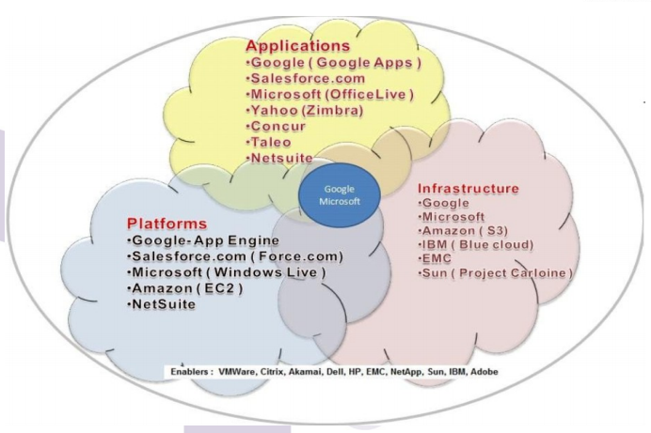

Slide 8
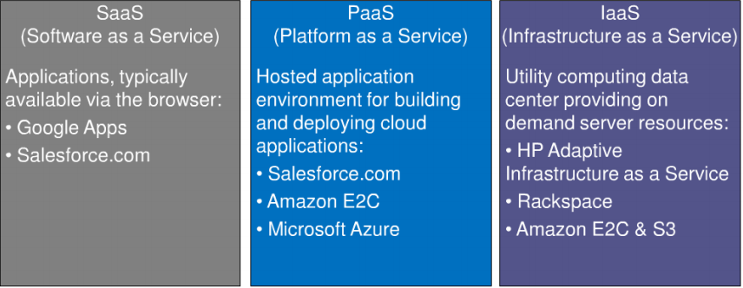

Slide 9
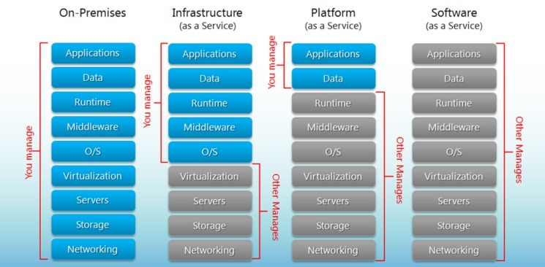

Slide 10

History of SaaS
 The term “SaaS” or software-as-a-service was first mentioned in an internal document called “Software as a Service: Strategic
Backgrounder” by the Software & Information Industry Association in 2000.

Slide 11

Introduction to SaaS
Software as a Service (SaaS), on demand software, is a software delivery model in which software and its associated data are hosted centrally and accessed using a thin-client, usually a web browser over the internet.
Eg
Gmail(Google)
Fb

Slide 12

Characteristics of SaaS
Easy customization
Better access
Multitenant architecture
Integration
Operational performance

Slide 13

characteristics
Multitenancy: This is an architecture whereby a single instance of a software app is meant to serve multiple customers.
Security and Compliance: The responsibility of the SaaS application and hardware security solely lies with the application developer. He should ensure that multiple tenants on a shared infrastructure have their data virtually segregated and made accessible to those individuals intended to access it.

Slide 14
Service Offered by SaaS
Enterprise Service | Web 2.0
Workflow Management | Desktop software
Groupware & Collaborative | Financial Management
Supply chain | Geo Spatial & Search
Digital Signation | Blogs
CRM | Wiki Services
Communications | Portal Services
 | Social Networking
 | Meta data Management

Slide 15

Types of SaaS
There are two types of SaaS
The Ups of SaaS
No need to buy the applications, deploy them and maintain them
No need to maintain the equipment and infrastructure.
Lower costs

Slide 16

The Downs of SaaS
Dependency on the SaaS provider
Security issues
Limited applications

Slide 17

Architecture of SaaS
Application design for SaaS or cloud infrastructure requires a number of key considerations to leverage the benefits delivered by the cloud. The design of the traditional applications considered limited resources.

Slide 18

Architecture of SaaS
Vertical SaaS
A Software which answers the needs of a specific industry (e.g., software for the healthcare, agriculture, real estate, finance industries)
Horizontal SaaS
The products which focus on a software category (marketing, sales, developer tools, HR) but are industry agnostic

Slide 19
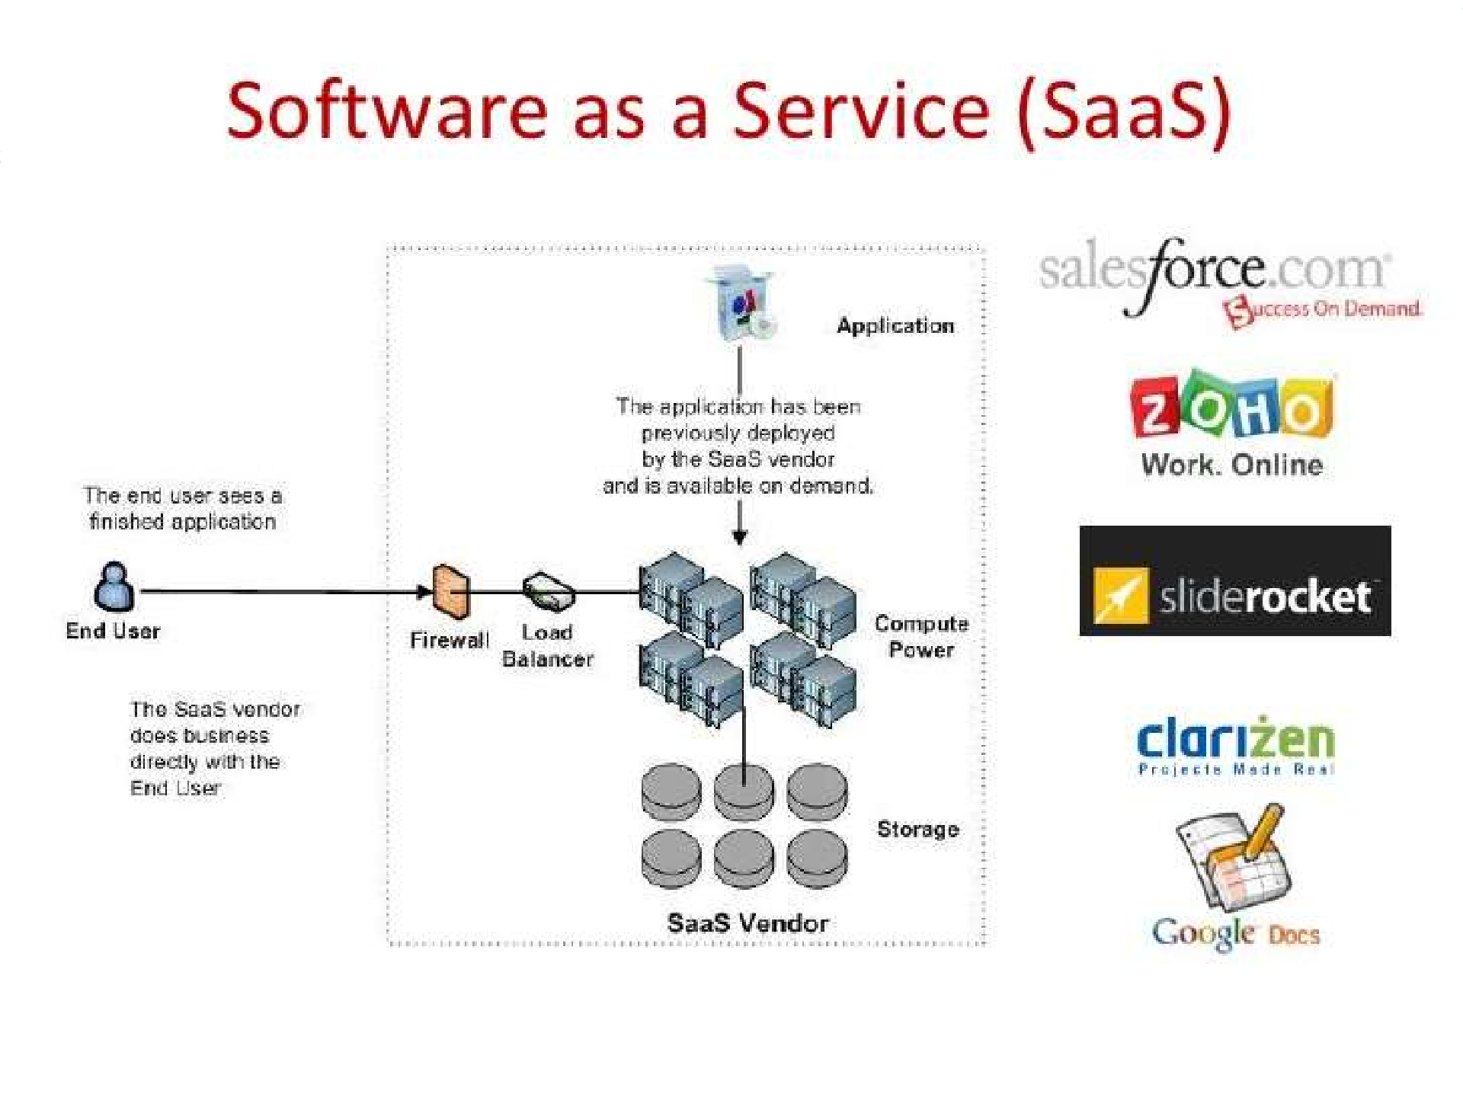



Slide 20
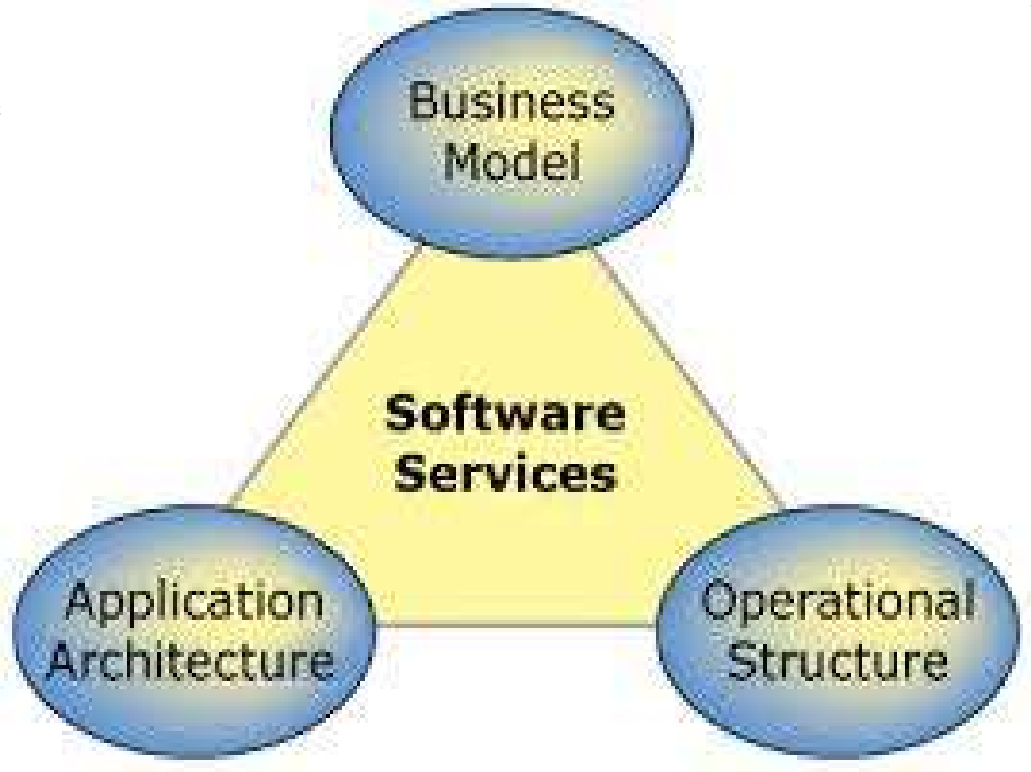


Slide 21

SaaS providers
SalesForce
LinkedIn
Workday
Netsuite
ServiceNow
Concur Technologies

Slide 22

Advantages
Easy to use
Scalability
Vendor accountability

Slide 23

Disadvantages
Robustness
Privacy
Security
Reliability
Compliance
Performance

Slide 24

Conclusion
Use of SaaS services is pervasive in the development and deployment of modern applications
In conclusion, the SaaS methodology is very mature and would play a central to the future of computing.

Slide 25
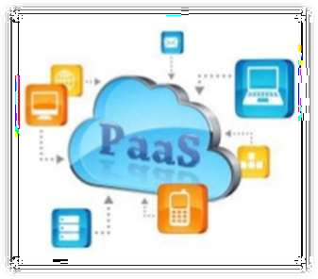
Platform as a Service (PaaS)

Slide 26
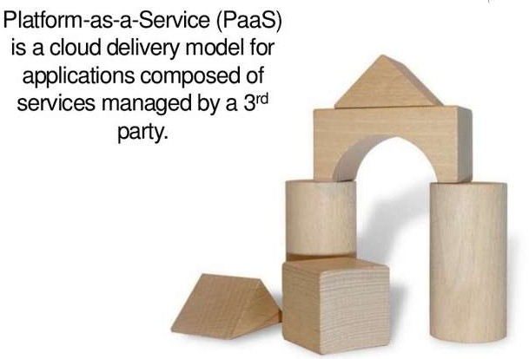
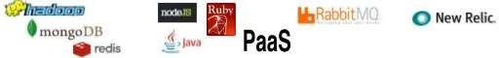

Slide 27
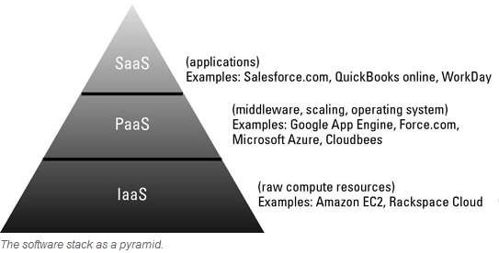
PaaS in Cloud Computing
Includes services for developing and deploying applications.
It is an abstracted and integrated cloud-based computing environment that supports the development, running, and management of applications.
A primary value of a PaaS environment is that developers don’t have to be concerned with
some of the lower-level details of
the environment.

Slide 28
What is PaaS ?
PaaS, is a category of cloud computing that provides a platform and environment to allow developers to build applications and services over the Internet.
A “cloud aware” application development and deployment environment.
An abstraction layer between your cloud application and your IaaS provider.

Slide 29
What is PaaS ?
PaaS services are hosted in the cloud and accessed by users simply via their web browser.
Fundamentally provides elastic scaling of your application.
Deployments include public, private and hybrid cloud configurations.
Example PaaS services:
Data services,
Application runtime,
Messaging & queueing,
Application management.

Slide 30
PaaS
Platform as a Service (PaaS) is a way to rent hardware, operating systems, storage and network capacity over the Internet.
The service delivery model allows the customer to rent virtualized servers and associated services for running existing applications or developing and testing new ones.
It is an outgrowth of SaaS, a software distribution model in which hosted software applications are made available to customers over the Internet.

Slide 31
PaaS Goal
Create an abstracted environment that supports an efficient, cost-effective, and repeatable process for the creation and deployment of high-quality applications.
Focus on Development, not Ops
Programmers’ development environment
Presentation layer: HTML, CSS, JavaScript
Control layer: Web Server code
Data layer: Data Model
Optionally, analytics

Slide 32
PaaS Goal
Cloud operations (CloudOps) is the management, delivery and consumption of software in a computing environment where there is limited visibility into an app's underlying infrastructure
Ops below
Made visible through a web interface
configuration management
resource allocation
optimizing performance capacity;
managing compliance burden
Operating system
File system
User authentication
Utilities (cron, etc.)
Logs
Database maintenance, backups, etc.

Slide 33
How PaaS works
Platform as a Service allows users to create software applications using tools supplied by the provider.
PaaS services can consist of preconfigured features that customers can subscribe to; they can choose to include the features that meet their requirements while discarding those that do not.
The infrastructure and applications are managed for customers and support is available.
Services are constantly updated, with existing features upgraded and additional features added.

Slide 34
PaaS does that
PaaS enables an organization to do the following:
Leverage key middleware services without having to deal with the complexities of managing individual hardware and software elements.
Access a complete stack of development and deployment tools via a web browser, a middleware environment where APIs can be used to plug into selected development and deployment tools. A developer might also leverage a full desktop development environment.
Overcome the challenges of managing lots of individual development and deployment tools by providing a suite of integrated and standardized tools — operating systems, security products, and the like — that meet company requirements.

Slide 35
Payment
As with most cloud offerings, PaaS services are generally paid for on a subscription basis with clients ultimately paying just for what they use.
Clients also benefit from the economies of scale that arise from the sharing of the underlying physical infrastructure between users, and that results in lower costs.

Slide 36
PaaS offers
Below are some of the features that can be included with a PaaS offering:
Operating system
Server-side scripting environment
Database management system
Server Software
Support
Storage
Network access
Tools for design and development & Hosting

Slide 37
Who can use PaaS services?
Software developers
web developers and
businesses can benefit from PaaS.
For example, web developers can use individual PaaS environments at every stage of the process to develop, test and ultimately host their websites. However, businesses that are developing their own internal software can also utilise Platform as a Service, particularly to create distinct ring-fenced development and testing environments.

Slide 38
Seperation of Duties
Development and infrastructure teams often clash when building software.
Ideally, there is a clear separation of duties and clean handoffs.

Slide 39
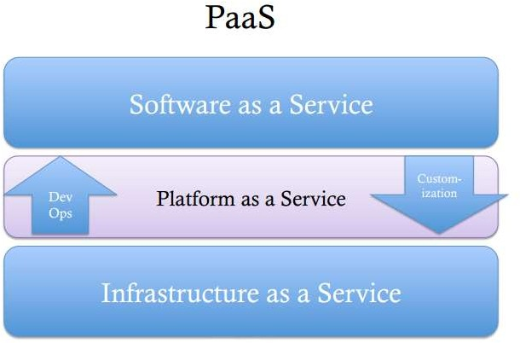

Slide 40
Evolving from different standards
Evolving “upwards” from IaaS
Amazon (Mail, Notification, Events, Databases, Workflow, etc.)
Evolving “downwards” from SaaS
Force.com – a place to host additional per-tenant logic.
Google App Engine
Evolving “sideways” from middleware platforms
WSO2, Tibco, vmWare, Oracle, IBM

Slide 41
Deployment System
Methods for continuous deployment
Upload
Version management

Slide 42
What do I care about (As a developer) ?
My code – running
Not a “VM” but a Virtual App Server
Not just code
I like Queues and Topics, ESB flows, Workflows, Databases, Logs, Portals, etc.
Not just Runtime
I like SVN, Git, build, continuous integration, code coverage, automated test
Moreover, if you are a manager of a group of developers, you probably like governance.

Slide 43
Beginning to use PaaS
One of the decisions you need to make when beginning to use a PaaS is whether you want to maintain the software or if you want the vendor to be the administrator.

Slide 44
Maintain the software yourself
If you choose to maintain the software yourself, you must set up, configure, maintain, and administer the PaaS yourself (either on a public or private cloud).

Slide 45
Let the vendor be the administrator
Alternatively, you can have the vendor to provide these services. The result is reduced friction between the development and deployment teams. There will, of course, be situations in which it’s critical for the internal team to control and manage a complex software environment.

Slide 46
Best Practices
Start with the data, and work up to the services and UI. No matter what the PaaS provider suggests.
Define a staging and testing strategy before you begin development.
Consider SOA approaches in the design and deployment of the PaaS- bases application.
Make sure to do load testing along with functional testing.
Make sure to model performance.
Don’t fall in love with a PaaS player, you may need to use several.

Slide 47
Primary Benefits of PaaS
Lower development costs (%30+)
Lower deployment and DevOps costs (Nearly eliminate)
Application portability (depends on the PaaS)

Slide 48
Benefits for Developers
Below are some of the benefits of PaaS to application developers:
They don’t have to invest in physical infrastructure (being able to ‘rent’ virtual infrastructure)
They don’t have to be concerned with some of the lower-level details of the environment.
Makes development possible for ‘non-experts’
Flexibility
Adaptability
Teams in various locations can work together & Security

Slide 49

IaaS
Infrastructure as a Service

Slide 50
Infrastructure as a Service (IaaS)
Computing elements as service on demand

Slide 51
Learning Objectives
At the end of the this lesson learner be able to
Articulate the meaning of IaaS,
Appreciate its characteristics
know some of its appropriate uses and
where IaaS inappropriate

Slide 52
Infrastructure as a Service
Infrastructure as a service ( IaaS) is a means of delivering computing infrastructure as an on- demand service.
It is one of the three fundamental cloud service models

Slide 53
Computing Infrastructure
Iaas provides the following
Servers- compute, machines
Storage
Network
Operating system

Slide 54
How does IaaS Works?
servers, software, data center space or network
The user instead of purchasing-
equipment, rent those resources as a fully
outsourced service on-demand model.

Slide 55
IaaS- Categories
IaaS can be obtained as
(1)
(2)
(3)
Public or
Private infrastructure or combination of both
Public Cloud is considered infrastructure that consists of shared resources, deployed on a self-service basis over the Internet.
Private cloud incorporates some of cloud computing features such as Virtualization, but does so on a private network

Slide 56
IaaS- Characteristics
Resources are distributed as a service
Allows dynamic scaling ( 1...10....100.....)
Has a variable costs-
Generally includes multiple-users on a single piece of hardware. (multi-tenancy)

Slide 57
IaaS- Appropriate uses
IaaS is useful in the following situations
1.
where demand is very volatile- any time there are significant spikes and troughs in terms of demand on the infracture
o amazon.in, snapdeal, flipkart- during festival season

Slide 58
IaaS- Appropriate uses
IaaS is useful in the following situations
2.
For new enterprise without capital to invest in hardware
o entrepreneurs starting on a shoestring budget

Slide 59
IaaS- Appropriate uses
IaaS is useful in the following situations
3.
Where the enterprise is growing rapidly and scaling hardware would be problematic
o a company that experience huge success immediately

Slide 60
IaaS- Appropriate uses
IaaS is useful in the following situations
4.
Where the enterprise is growing rapidly and scaling hardware would be problematic
o a company that experience huge success immediately - animato, pinterest

Slide 61
IaaS- Appropriate uses
IaaS is useful in the following situations
5.
For specific line of business, trial or temporary infrastructural needs

Slide 62
IaaS- inappropriate use
Where regulatory compliance makes the offshoring or outsourcing of data storage and processing difficult
personal information, medical information can not be stored in another country
Where the highest levels of performance are required, and on- premise or dedicated hosted infrastructure has the capacity to meet the organization’s needs
network latency,

Slide 63
Conclusion
IaaS is one of three fundamental cloud service models
IaaS provides basic computing resources- storage, servers, software networks
Iaas resources are provided on-demand and utility model

Slide 64
Introduction to IaaS
IaaS:
– Infrastructure as a Service (IaaS) is a form of cloud computing that provides virtualized computing resources over the Internet.
IaaS is one of three main categories of cloud computing services, alongside
In an IaaS model, a third-party provider hosts hardware, software, servers,
storage and other infrastructure components on behalf of its users.
IaaS providers also host users' applications and handle tasks including system maintenance, backup and resiliency planning. Software as a Service (SaaS) and Platform as a Service (PaaS)..

Slide 65
Advantages of IaaS
Eliminates capital expense and reduces ongoing cost.
Improves business continuity and disaster recovery.
Innovate rapidly.
Respond quicker to shifting business conditions.
Focus on your core business.
Increase stability, reliability and supportability.
Better security.
Gets new apps to users faster.

Slide 66
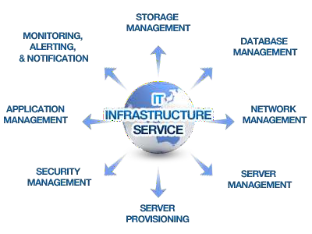
IaaS

Slide 67
Common IaaS business scenarios
Typical things businesses do with IaaS include:
Test and development. Teams can quickly set up and dismantle test and development environments, bringing new applications to market faster. IaaS makes it quick and economical to scale up dev-test environments up and down.
Website hosting. Running websites using IaaS can be less expensive than traditional web hosting.
Storage, backup and recovery. Organizations avoid the capital outlay for storage and complexity of storage management, which typically requires a skilled staff to manage data and meet legal and compliance requirements. IaaS is useful for handling unpredictable demand and steadily growing storage needs. It can also simplify planning and management of backup and recovery systems.

Slide 68
Common IaaS Business Scenarios
Web apps. IaaS provides all the infrastructure to support web apps, including storage, web and application servers and networking resources. Organisations can quickly deploy web apps on IaaS and easily scale infrastructure up and down when demand for the apps is unpredictable.
High-performance computing. High-performance computing (HPC) on supercomputers, computer grids or computer clusters helps solve complex problems involving millions of variables or calculations. Examples include earthquake and protein folding simulations, climate and weather predictions, financial modeling and evaluating product designs.
Big data analysis. Big data is a popular term for massive data sets that contain potentially valuable patterns, trends and associations. Mining data sets to locate or tease out these hidden patterns requires a huge amount of processing power, which IaaS economically provides.

Slide 69
Characteristics of SaaS, PaaS &IaaS
SaaS
Web access to commercial software
S/w is managed from central location
s/w is delivered in a one to many model
Uses not required to handle s/w upgrades and patches
API allow for integration between different pieces of s/w
PaaS
Multitenant Architecture
Built in scalability of deployed s/w including load balancing and failover
Integration with web services and databases via common stds.
Support for development team collaboration- solutions include project planning & communication tools.
IaaS
Resources are distributed as a service
Allows for dynamic scaling

Slide 70
UNIT-II

Slide 71




List of Topics
What are Web Services ?
How it works ?
Why Web Services?
Architecture
Components
Security
How Web Service is implemented?
Web services samples
REST

Slide 72

What are web services?
Web Services can convert your application into a Web- application which can publish its function or message to the rest of the world.
The basic Web Services platform is XML + HTTP
A application which run on web (Internet or Intranet) and provides generic services.
The services provided are through the web and in a standardized format which makes it generic and independent on the platform or the protocol on which the service was requested.

Slide 73

What are Web Services cont...
Web services are open standard ( XML, SOAP, HTTP etc.) based Web applications that interact with other web applications for the purpose of exchanging data
There are two types of Webservices
SOAP (JAX-WS , Java API for XML Web Services)
REST (JAX-RS, Java API for RESTful Web Services)

Slide 74
What are Web Services cont...
To summarize, a complete web service is, therefore, any service that:
Is available over the Internet or private (intranet) networks
Uses a standardized XML messaging system
Is not tied to any one operating system or programming language
Is self-describing via a common XML grammar
Is discoverable via a simple find mechanism

Slide 75

Why Web services ?
Exposing the existing function on to network:
A Web service is a unit of managed code that can be remotely invoked using HTTP, that is, it can be activated using HTTP requests. So, Web Services allows you to expose the functionality of your existing code over the network. Once it is exposed on the network, other application can use the functionality of your program.

Slide 76
Why Web services ?
Connecting Different Applications i.e. Interoperability:
Web Services allows different applications to talk to each other and share data and services among themselves. Other applications can also use the services of the web services.
For example VB or .NET application can talk to java web services and vice versa. So, Web services is used to make the application platform and technology independent.

Slide 77

Why Web services continued…
Standardized Protocol:
Web Services uses standardized industry standard protocol for the communication.
All the four layers (Service Transport, XML Messaging, Service Description and Service Discovery layers) uses the well defined protocol in the Web Services protocol stack.
This standardization of protocol stack gives the business many advantages like wide range of choices, reduction in the cost due to competition and increase in the quality.

Slide 78
Why Web services continued…
Low Cost of communication:
Web Services uses SOAP over HTTP protocol for the communication, so you can use your existing low cost internet for implementing Web Services. Beside SOAP over HTTP, Web Services can also be implemented on other reliable transport mechanisms like FTP etc.

Slide 79

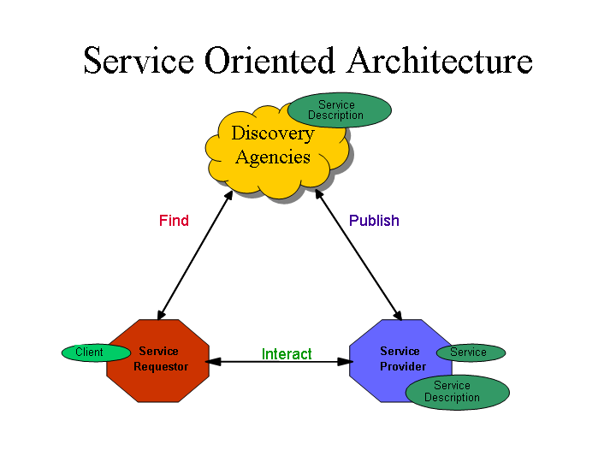
Architecture

Slide 80

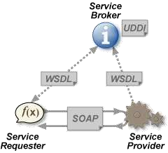
Architecture cont…

Slide 81

Web service roles
There are three major roles within the web service architecture
Service provider: This is the provider of the web service. The service provider implements the service and makes it available on the Internet.
Service requestor: This is any consumer of the web service. The requestor utilizes an existing web service by opening a network connection and sending an XML request.
Service registry: This is a logically centralized directory of services.
The registry provides a central place where developers can publish new
services or find existing ones.

Slide 82

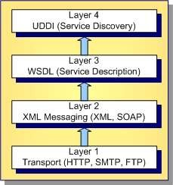
Web Service protocol stack

Slide 83

Protocol stack cont…
Service transport: This layer is responsible for transporting messages between applications. Currently, this layer includes hypertext transfer protocol (HTTP), Simple Mail Transfer Protocol (SMTP), file transfer protocol (FTP), and newer protocols, such as Blocks Extensible Exchange Protocol (BEEP).
XML messaging: This layer is responsible for encoding messages in a common XML format so that messages can be understood at either end. Currently, this layer includes XML-RPC and SOAP.

Slide 84
Protocol stack cont…
Service description: This layer is responsible for describing the public interface to a specific web service. Currently, service description is handled via the Web Service Description Language (WSDL).
Service discovery: This layer is responsible for centralizing services into a common registry, and providing easy publish/find functionality. Currently, service discovery is handled via Universal Description, Discovery, and Integration (UDDI).

Slide 85

Components of Web Service
SOAP (Simple Object Access Protocol)
Protocol based on XML , used for message transfer
WSDL (Web Service Description Language)
XML file used to describe the Web service and how to access them
UDDI (Universal Description and Discovery Integration)
Used to register and search for web service
Directory of web service
JAX-RPC
For intercommunication
HTTP
For message transfer

Slide 86

What is SOAP?
SOAP is an XML-based protocol to let applications exchange information over HTTP.
Or more simple: SOAP is a protocol for accessing a Web Service.
SOAP stands for Simple Object Access Protocol
SOAP is a communication protocol
SOAP is a format for sending messages
SOAP is designed to communicate via Internet
SOAP is platform independent
SOAP is language independent
SOAP is based on XML
SOAP is simple and extensible
SOAP allows you to get around firewalls
SOAP is a W3C standard

Slide 87

What is WSDL?
WSDL is an XML-based language for locating and describing Web services.
WSDL stands for Web Services Description Language
WSDL is based on XML
WSDL is used to describe Web services
WSDL is used to locate Web services
WSDL is a W3C standard

Slide 88

What is UDDI?
UDDI is a directory service where companies can register and search for
Web services.
UDDI stands for Universal Description, Discovery and Integration
UDDI is a directory for storing information about web
services
UDDI is a directory of web service interfaces described by WSDL
UDDI communicates via SOAP

Slide 89

XML-RPC
This is the simplest XML based protocol for exchanging information between computers.
XML-RPC is a simple protocol that uses XML messages to perform RPCs.
Requests are encoded in XML and sent via HTTP POST.
XML responses are embedded in the body of the HTTP response.
XML-RPC is platform-independent.
XML-RPC allows diverse applications to communicate.
XML-RPC is the easiest way to get started with web services.

Slide 90

Security
 Confidentiality
If a client sends an XML request to a server, then question is that can we ensure that the communication remains confidential?
Answer lies here
XML-RPC and SOAP run primarily on top of HTTP.
HTTP has support for Secure Sockets Layer (SSL).
Communication can be encrypted via the SSL.
SSL is a proven technology and widely deployed.


Slide 91
Security
 Authentication
If a client connects to a web service, how do we identify the user? And is the user authorized to use the service?
Following options can be considered but there is no clear consensus on a strong authentication scheme.
 HTTP includes built-in support for Basic and Digest authentication, and services can therefore be protected in much the same manner as HTML documents are currently protected.
SOAP Security Extensions: Digital Signature (SOAP-DSIG). DSIG leverages public key cryptography to digitally sign SOAP messages. This enables the client or server to validate the identity of the other party.
The Organization for the Advancement of Structured Information Standards (OASIS) is working on the Security Assertion Markup Language (SAML, It is an XML-based open standard data format for exchanging authentication and authorization data between parties, in particular, between an identity provider and a service provider).

Slide 92

Security cont…
 Network Security
There is currently no easy answer to this problem, and it has been the subject of much debate. For now, if you are truly intent on filtering out SOAP or XML- RPC messages, one possibility is to filter out all HTTP POST requests that set their content type to text/xml.

Slide 93

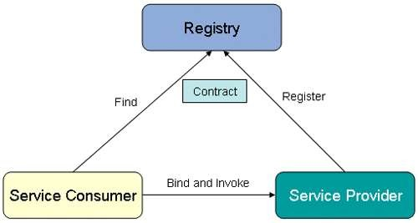
How Web Service is implemented ?
Build and Publish
Find
Bind and Invoke

Slide 94

Web Service Implementation Cont…
Pre Conditions
No one will be able to use your service
Step 1 :Build and Publish
Build
Create your application
Create your contract file (WSDL)
Publish
Register your application as a web service onto any registry
This process happens on UDDI using a separate SOAP request
This process is useful only if your web service should be accessible using Internet
Post conditions
Your web service will be available to the Public (If published to any registry) or will be accessible to intranet users

Slide 95

Web Service Implementation Cont…
Pre Conditions
The user needs to access a service but is not aware of the service details
Step 2 :Find
Find
Search in the registry for a service which provides your needs
Obtain the necessary details about the service
Post conditions
The user will have all the details about the service and gets ready to contact the service

Slide 96

Web Service Implementation Cont…
Pre Conditions
The user will have the contract necessary to identify and call the
service
Step 3 :Bind
Bind
Use the contract file to build the request message.
Invoke
Send a request to the service and request for the necessary operation available from the service.
The request should be sent in the protocol which is required by the
service
Post conditions
The user will receive the response from the service in a format specified in the contract file.

Slide 97

Web Services samples
Eclipse tutorial link : http://www.eclipse.org/webtools/jst/components/ws/1.5/tutorials/ind ex.html
Bottom to Top approach
JAVA to WSDL
Top to bottom approach
WSDL to JAVA

Slide 98
Amazon Elastic Compute Cloud (EC2)

Slide 99
Amazon Elastic Compute Cloud (EC2)
Resizable compute capacity
Complete control of your computing resources
Reduces the time required to obtain and boot new server instances to minutes
Amazon EC2

Slide 100
Amazon EC2 Facts
Scale capacity as your computing requirements change Pay only for capacity that you actually use
Choose Linux or Windows
Deploy across AWS Regions and Availability Zones for reliability

Slide 101
Amazon’s service lets customers choose from three sizes of virtual servers:
Small, which offers the equivalent of a system with 1.7GB of memory, 160GB of storage, and one virtual 32-bit core processor
Large, which offers the equivalent of a system with 7.5GB of memory, 850GB of storage, and two 64-bit virtual core processors
Extra large, which offers the equivalent of a system with 15GB of memory, 1.7TB of storage, and four virtual 64-bit core processors

Slide 102
Launching an Amazon EC2 Instance via the Web Console
Determine the AWS Region in which you want to launch the Amazon EC2 instance.
Launch an Amazon EC2 instance from a pre-configured Amazon Machine Image (AMI).
Choose an instance type based on CPU, memory, storage, and network requirements.
Configure network, IP address, security groups, storage
volume, tags, and key pair.

Slide 103
AMI Details
An AMI includes the following:
A template for the root volume for the instance (for example, an operating system, an application server, and applications).
Launch permissions that control which AWS accounts can use the AMI to launch instances.
A block device mapping that specifies the volumes to attach to the instance when it's launched.

Slide 104










Instances and AMIs
Select an AMI based on:
Region
Operating system Architecture (32-bit or 64-bit) Launch permissions
Storage for the root device
Launch instances of any type
Instance
Host computer
AMI
Instances
Host computer

Slide 105





Amazon EC2 Instances
AMI
Instances
Instances
Instances
OS, Applications, & Configuration
Running or Stopped VM
EBS
EBS EBS
AZ
EBS
EBS EBS
AZ
EBS
Snapshots
S3
Region
S3 Buckets

Slide 106
Amazon EBS vs. Amazon EC2 Instance Store
Amazon EBS
Data stored on an Amazon EBS volume can persist independently of the life of the instance.
Storage is persistent.
Amazon EC2 Instance Store
Data stored on a local instance store persists only as long as the
instance is alive.
Storage is ephemeral.

Slide 107
AMI Types - Storage for the Root Device
Characteristic | Amazon EBS-Backed | Amazon Instance Store-Backed
Boot time | Usually < 1 minute | Usually < 5 minutes
Size limit | 16 TiB | 10 GiB
Data persistence | The root volume is deleted when the instance terminates. Data on any other Amazon EBS volumes persists after instance termination. | Data on any instance store volumes persists only during the life of the instance.
Charges | Instance usage, Amazon EBS volume usage, and storing your AMI as an Amazon EBS snapshot. | Instance usage and storing your AMI in Amazon S3.
Stopped state | Can be stopped. | Cannot be stopped.

Slide 108
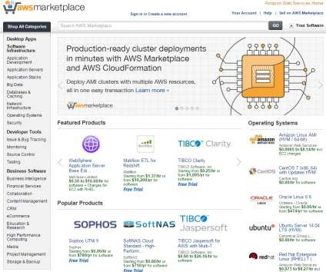
AWS Marketplace – IT Software Optimized for the Cloud
AWS Marketplace:
Is an online store to discover, purchase, and deploy IT software on top of the AWS infrastructure.
Catalog of 2300+ IT software solutions
Including Paid, BYOL, Open Source, SaaS, &
free to try options
Pre-configured to operate on AWS
Software checked by AWS for security and operability
Deploys to AWS environment in minutes
Flexible, usage-based billing models
Software charges billed to AWS account
Includes AWS Test Drive. https://aws.amazon.com/marketplace

Slide 109
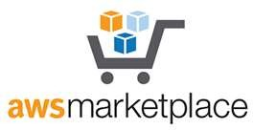
AWS Marketplace
Enable success in the cloud with software access across
your technology stack.
Software Categories
Business Intelligence
Media
Dev Ops
Security
Open Source & OS
Database
Network
Storage
And Many More

Slide 110
DevOps
DevOps is a set of practices that works to automate and integrate the processes between software development and IT teams, so they can build, test, and release software faster and more reliably.
The term DevOps was formed by combining the words “development” and “operations” and signifies a cultural shift that bridges the gap between development and operation teams, which historically functioned in siloes.

Slide 111

















AWS Marketplace
Leverage a broad catalog of IT software to support your
workload needs.

Slide 112
Choosing the Right Amazon EC2 Instance
EC2 instance types are optimized for different use cases and come in multiple sizes. This allows you to optimally scale resources to your workload requirements.
AWS uses Intel® Xeon® processors for EC2 instances, providing
customers with high performance and value.
Consider the following when choosing your instances: Core count, memory size, storage size and type, network performance, and CPU technologies.
Hurry Up and Go Idle - A larger compute instance can save you time and money, therefore paying more per hour for a shorter amount of time can be less expensive.

Slide 113

Get the Intel® Advantage
Intel’s latest 22nm Haswell microarchitecture on new C4 instances,
with custom Intel® Xeon® v3 processors, provides new features:
Haswell microarchitecture has better branch prediction; greater efficiency at prefetching instructions and data; along with other improvements that can boost existing applications’ performance by 30% or more
P state and C state control provides the ability to individually tune each cores performance and sleep states to improve application performance
Intel® AVX2.0 instructions can double the floating-point performance for compute-intensive workloads over Intel® AVX, and provide additional instructions useful for compression and encryption

Slide 114
Intel® Processor Technologies
Intel® AVX – Get dramatically better performance for highly parallel HPC workloads such as life science engineering, data mining, financial analysis, or other technical computing applications. AVX also enhances image, video, and audio processing.
Intel® AES-NI – Enhance your security with these new encryption instructions that reduce the performance penalty associated with encrypting/decrypting data.
Intel® Turbo Boost Technology – Get more computing power when you need it with performance that adapts to spikes in your workload with Intel® Turbo Boost Technology 2.0

Slide 115

EC2 Instances with Intel® Technologies
Burstable
Balanced
Compute
Memory
GPU
I/O
Storage
AWS Instance Type | T2 | M4 | C4 | R3 | G2 | I2 | D2
Intel® processor | Intel® Xeon® family | Intel® Xeon® E5-2676 v3 | Intel® Xeon® E5-2666 v3 | Intel® Xeon® E5-2670 v2 | Intel® Xeon® E5-2670 | Intel® Xeon® E5-2670 v2 | Intel® Xeon® E5-2676 v3
Intel® process technology |  | 22nm Haswell | 22nm Haswell | 22nm Ivy Bridge | 32nm Sandy Bridge | 22nm Ivy Bridge | 22nm Haswell
Intel® AVX
Intel® AVX2
Intel® Turbo Boost
Storage | EBS only | EBS only | EBS only | SSD | SSD | SSD | HDD

Slide 116
Current Generation Instances
Instance Family | Some Use Cases
General purpose (t2, m4, m3) | Low-traffic websites and web applications Small databases and mid-size databases
Compute optimized (c4, c3) | High performance front-end fleets Video-encoding
Memory optimized (r3) | High performance databases Distributed memory caches
Storage optimized (i2, d2) | Data warehousing Log or data-processing applications
GPU instances (g2) | 3D application streaming Machine learning

Slide 117
Instance Metadata & User Data
Instance Metadata:
Is data about your instance.
Can be used to configure or manage a running instance.
Instance User Data:
Can be passed to the instance at launch. Can be used to perform common automated configuration tasks.
Runs scripts after the instance starts.

Slide 118
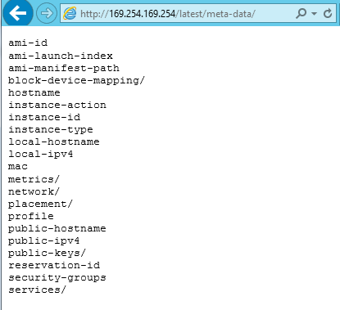
Retrieving Instance Metadata
To view all categories of instance metadata from within a running instance, use the following URI: http://169.254.169.254/latest/meta- data/
On a Linux instance, you can use:
$ curl http://169.254.169.254/latest/meta-data/
$ GET http://169.254.169.254/latest/meta-data/
All metadata is returned as text (content type text/plain).

Slide 119
Adding User Data
You can specify user data when launching an
instance.
User data can be:
Linux script – executed by cloud-init
Windows batch or PowerShell scripts – executed by
EC2Config service
User data scripts run once per instance-id by default.

Slide 120

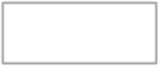
User Data Example Linux
User data shell scripts must start with the #! characters and the path to the interpreter you want to read the script.
#!/bin/sh
yum -y install httpd
chkconfig httpd on
/etc/init.d/httpd start
Install Apache web server Enable the web server Start the web server

Slide 121




User Data Example Windows
Import the Server Manager module
for Windows PowerShell.
<powershell>
Import-Module ServerManager
Install-WindowsFeature web-server, web-webserver Install-WindowsFeature web-mgmt-tools
</powershell>
Install IIS
Install Web Management Tools

Slide 122
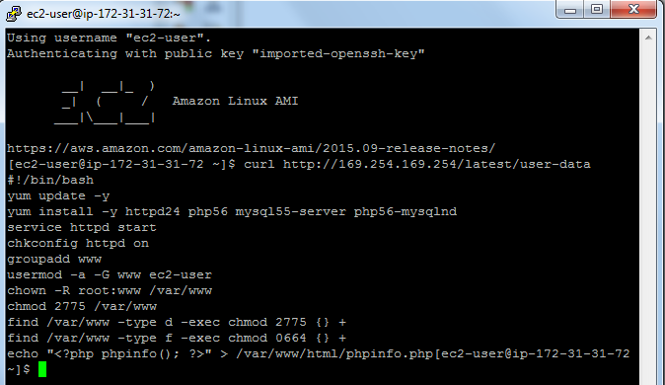
Retrieving User Data
To retrieve user data, use the following URI: http://169.254.169.254/ latest/user-data
On a Linux instance, you can use:
$ curl
http://169.254.169.254
/latest/user-data/
$ GET
http://169.254.169.254
/latest/user-data/

Slide 123








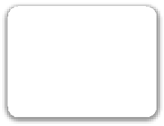

Amazon EC2 Purchasing Options
On-Demand Instances
Reserved Instances
Scheduled Instances
Dedicated Hosts
Spot Instances
Purchase at significant discount. Instances are always available.
Physical host is fully dedicated to run your instances. Bring your per-socket, per-core, or per- VM software licenses to reduce cost.
Highest bidder uses instance at a significant discount.
Spot blocks supported.
Purchase a 1- year RI for a recurring period of time.
Pay by the hour.
1-year to 3-year
terms.

Slide 124
Multi-entity support Multi-schema approach Multi-Tenant Architecture Cloud Service Management On Demand Computing

Slide 125
Multi-entity support
A multi-tenant cloud is a cloud computing architecture that allows customers to share computing resources in a public or private cloud.
Each tenant's data is isolated and remains invisible to other tenants.
In a multi-tenant cloud system, users have individualized space for storing their projects and data.

Slide 126
Benefits of multitenancy
Better use of resources:
One machine reserved for one tenant isn't efficient, as that one tenant is not likely to use all of the machine's computing power.
By sharing machines among multiple tenants, use of available resources is maximized.
Lower costs:
With multiple customers sharing resources, a cloud vendor can offer their services to many customers at a much lower cost than if each customer required their own dedicated infrastructure.

Slide 127
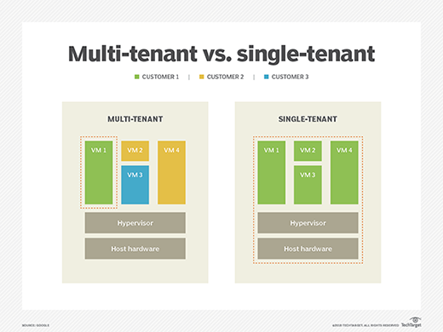
Single-Tenant vs. Multi-Tenant

Slide 128
Single-Tenant vs. Multi-Tenant
Single-Tenant Hosting | Multi-Tenant Hosting
*a client operates in a solely dedicated environment. | *each tenant is isolated from other tenants.
Advantage: | Advantage:
Greater customization | Simplified hosting
Greater isolation from security risks | Better protection of systems
Faster recovery | Upgrading software is no longer your problem
Better control
Avoiding “noisy neighbor” syndrome
Disadvantage: | Disadvantage:
Cost | They have their own security risks
Client responsibility | Downtime
Less efficient | Noise neighbors

Slide 129
Multitenancy in private cloud computing
Private cloud computing uses multitenant architecture that the other tenants are from the internal organizations.
In private cloud computing, different teams within Company A share infrastructure with each other.
Multitenancy is providers
Amazon Web Services and Microsoft Azure.
multitenancy is a , software as a service, is deployed by many software as a service companies.

Slide 130
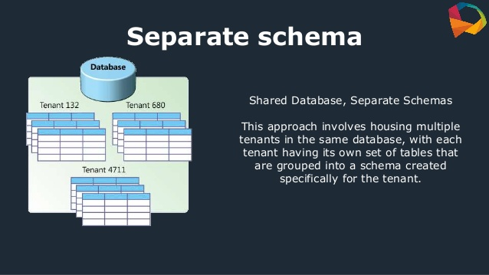
Multiple tenants in the same DB

Slide 131
Development of Multi-Tenant Architecture
In a multitenancy environment, multiple customers share the same application, in the same operating environment, on the same hardware, with the same storage mechanism.
In virtualization, every application runs on a separate virtual machine with its own OS.

Slide 132
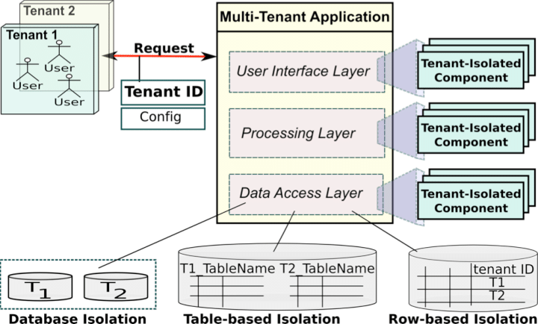
Multi-tenant architecture with tenant-isolated components

Slide 133
Multi-tenancy using cloud data stores
The cloud storage has both financial and security advantages.
Financial advantages in the case that the virtual resources are cheaper than dedicated physical resources connected to a personal computer or network.

Slide 134
Types of cloud storage
Personal Cloud Storage
Public Cloud Storage
Private Cloud Storage
Hybrid Cloud Storage

Slide 135
Types of cloud storage
Personal Cloud Storage:
It is also called mobile cloud storage which is a subset of public cloud storage that applies to storing an individual's data in the cloud and provides access to data from anywhere.
Apple's iCloud is an example of personal cloud storage.

Slide 136
Types of cloud storage
Public Cloud Storage:
Public cloud storage is where the storage service providers and enterprises are separate and there aren't any cloud resources stored in the enterprise's data center.
The enterprise data management is done by cloud storage provider.

Slide 137
Types of cloud storage
Private Cloud Storage:
A form of cloud storage where the data storage is done within the enterprise.
This helps to resolve the potential risk for performance and security concerns while still providing the advantages of cloud storage.

Slide 138
Types of cloud storage
Hybrid Cloud Storage:
Hybrid cloud storage is a combination of private and public cloud storage where some data that is critical resides in the enterprise's private cloud while other data is stored and accessible from a public storage provider.

Slide 139
Tenant Data Management in Multi-Tenant Cloud Systems
Multi-tenancy enables the client service providers to serve multiple clients by a single application instance, isolating each tenant’s data.
The benefits of this method include increased utilization of available hardware resources and improved ease of maintenance and deployment.
These results are in lower overall application costs.

Slide 140
Tenant Data Management in Multi-Tenant Cloud Systems
In a multi-tenant architecture, a software application is designed virtually to partition data.
Each tenant works in a virtual application instance in which some tenants may be divided into multiple subtenants, each having its own users.
As the number of tenants increases, a scalable architecture is needed

Slide 141
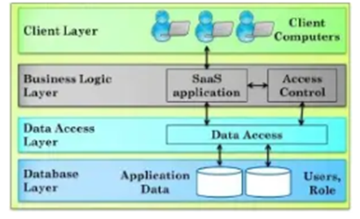
Tenant Data Management in Multi-Tenant Cloud Systems

Slide 142
Tenant Data Management in Multi-Tenant Cloud Systems
The business logic layer provides security by the access control component which should be isolated from the offered services.
The database layer stores the application data. To enforce scalability of the database layer a logical hierarchical representation of the tenants and subtenants, and making a mapping to the physical storage is followed.
The data access layer provides load balancing between the different data stores and stores the decision support for managing the data store.

Slide 143
Tenant Data Management in Multi-Tenant Cloud Systems
Tenants and subtenants in a multi-tenant organization can be structured hierarchically in the form of a tenant tree.
At the top level of the tree is the SaaS provider, which is the root node of the tenant tree.
Various tenants using the applications are located at the next level, and is the child nodes of SaaS provider.
All tenants share the same parent or root node.
Some tenants may be even divided into multiple subtenants.

Slide 144
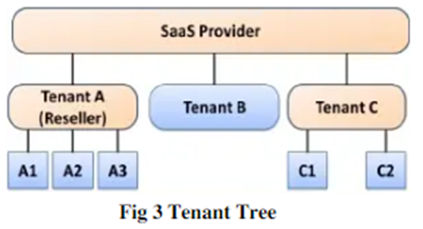
Tenant Tree

Slide 145
Tenant Data Management in Multi-Tenant Cloud Systems
The representation of tenants is done by logical hierarchical representation.
The data could be split as in the logical representation, by creating a data stores for tenants or merging smaller databases.
For small applications with a less number of tenants, can share a single data store.
There are 3 different models for load balancing

Slide 146
Cloud Service Management
The management of cloud infrastructure products and services is cloud management.
Public clouds are operated by public cloud service providers, which provide the servers, storage, networking and data centre operations of the public cloud environment.
With a third-party cloud management tool, users can also choose to manage their public cloud services.

Slide 147
Cloud Service Management
Public cloud service users can typically choose from three categories of specific cloud provisioning:
User self-provisioning: Users, usually via a web form or console interface, buy cloud services directly from the provider. On a per-transaction basis, the client pays.

Slide 148
Cloud Service Management
Advanced provisioning: A pre-determined sum of services scheduled in advance of operation is contracted in advance by customers. A flat fee or a monthly fee is charged by the consumer.
Dynamic provisioning: When the client requires them, the provider allocates resources, and then decommissions them when they are no longer required. On a pay-per-use basis, the client is paid.

Slide 149
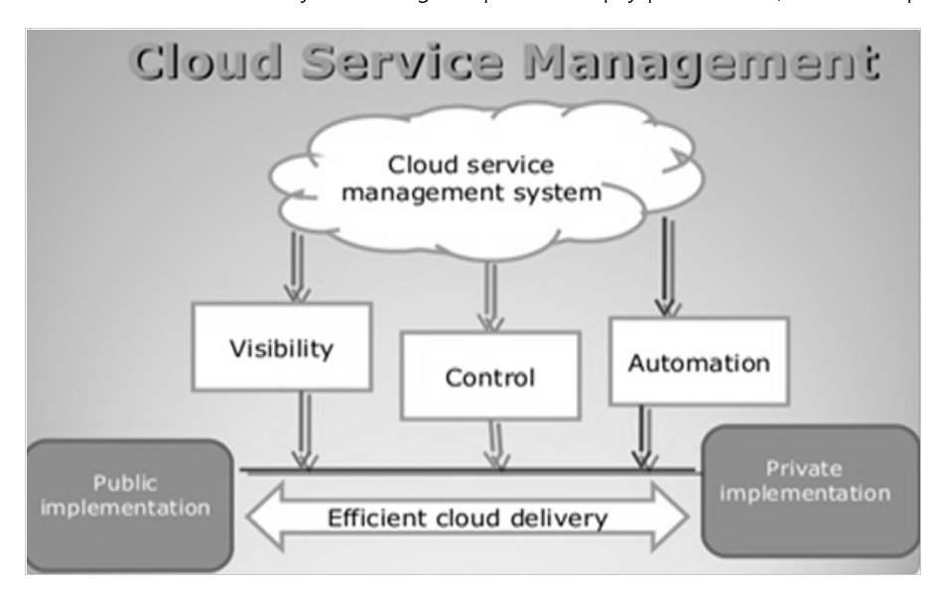
Cloud Service Management

Slide 150
On Demand Computing
Cloud Computing vs. Grid Computing
Grid Computing is computing technology that includes a combination of computer resources that offers seamless access to computing power and data storage capacity distributed over the globe.
Cloud Computing Developed from grid computing technology, cloud computing technology offers highly flexible on-demand provisioning of its resources

Slide 151
On-demand computing (ODC)
On-demand computing (ODC) is a business computing model that allows companies to provide access to computing resources as they become necessary, rather than full time
• a computing and communications infrastructure that facilitates flexible business service delivery and provides the basis for:
• Autonomic computing
• Fast response to external business-affecting changes.
• Adaptive business processes to protect revenues and contain costs
• Complex interactions inside and outside of organizational boundaries
• Resilience against external threats such as viruses, intrusions, and power outages.

Slide 152
How 'Cloud' differs from the 'Grid'?
Grid computing is focused towards solving a computational problem whereas Cloud computing is focused towards providing 'On Demand‘ services.
Types of services provided by Cloud Infrastructure
SaaS (Software as a Service)
b) PaaS ( Platform as a Service)
IaaS (Infrastructure as a Service)
Grid Computing is possible only with applications that can be parallelized whereas Cloud computing does not have any such restriction.

Slide 153
Grid Computing
• a special type of parallel computing that relies on complete connected to a network by a conventional network interface, such as Ethernet.
• combination of computer resources from multiple administrative domains to reach a common goal
• Grid size can vary by a considerable amount

Slide 154
Grid
In Grid, resource allocation is primarily controlled by the contract between the user (known as Virtual Organization) and allocator (known as Admin Domain).
Therefore a user, irrespective of his requirement will always get the resources ONLY as agreed upon in the contract. On the other hand in Cloud there is no such restriction.
Cloud supports 'On-Demand‘ provisioning as it follows the principle of 'Pay as you go'. Based on the user's requirements Cloud will allocate the required resources thus enabling easy scalability in order to achieve the desired SLA.

Slide 155
Cluster Computing
A group of linked computers, working together closely thus in many respects forming a single computer
• Cluster computing category
• High-availability (HA) clusters
• Load-balancing clusters
• Compute clusters Source: http://www.rdi.ku.ac.th/Techno_ku60/res-96/index96.html

Slide 156
Cluster Computing categories
High-availability (HA):
clusters are linked together to share computational workload or function as a single virtual computer
• Load-balancing clusters: multiple computers are linked together to share computational workload or function as a single virtual computer
• Compute clusters: Often clusters are used primarily for computational purposes, rather than handling IO-oriented operations such as web service or databases

Slide 157
Cluster computing categorized by connection
• Closed system cluster computing
• Internal Connected
• high security
• only 1 IP address, each node cannot manage external data
• Open system cluster computing
• Direct connect to external network
• each node has its own IP address
• suitable for being web servers or ftp servers

Slide 158




Slide 159



